Slide 1
node.js class – iteration 1
Creating content for the class
Sigge, Sanal, Jashif, Ehsan, Helsingborg 2020

Slide 2
Introduction Google cloud platform
Google Cloud Platform is a set of services that enables developers to build, test and deploy applications on Google’s reliable infrastructure.​
As a developer, think of cloud computing as a service that provides a resource that your application needs to work (this resource may be a platform, an infrastructure (i.e. servers), a framework..)​

Slide 3
Cloud Service Levels
Salesforce.com. Google apps,etc
SaaS
Google app engine, Window azure,Cloud foundry
PaaS
Cloud storage, Amazon EC2,
IaaS

Slide 4
Why Cloud
Rapid development, deploy and iterate your applications without worrying about system administration. Google manages your application, database and storage servers.
This enables us to focus on the product
➔ Managed services
➔ Developer Tools and SDKs
➔ Console and Administration

Slide 5
Benefits of using cloud services
You can mix and match services from various cloud offerings
Google Cloud Platform has all the services your application architecture needs.
Virtual machines. Managed platform. Blob storage. NoSQL datastore. MySQL database. Big Data analytics.
Compute.
Storage.
Services.
Applications hosted on Cloud Platform can automatically scale up to handle the most demanding workloads and scale down when traffic subsides. You pay only for what you use.
Scale-up: Cloud Platform is designed to scale like Google’s own products, even when you experience a huge traffic spike. Managed services such as App Engine or Cloud Datastore give you auto-scaling that enables your application to grow with your users.
Scale-down: Just as Cloud Platform allows you to scale-up, managed services also scale down. You don’t pay for computing resources that you don’t need.

Slide 6
What is serverless
Serverless computing (or serverless for short), is an execution model where the cloud provider (AWS, Azure, or Google Cloud) is responsible for executing a piece of code by dynamically allocating the resources. There by only charging for resources used to run the code. The code is typically run inside stateless containers that can be triggered by a variety of events including http requests, database events, queuing services, monitoring alerts, file uploads, scheduled events (cron jobs), etc. The code that is sent to the cloud provider for execution is usually in the form of a function. So serverless is sometimes referred to as “Functions as a Service” or “FaaS”.
Following are the FaaS offerings of the major cloud providers:
AWS: AWS Lambda
Microsoft Azure: Azure Functions
Google Cloud: Cloud Functions

Slide 7
How to setup cloud instance (Prerequisites)
Google Account
Sign up for a Google Cloud Free Program
e Cloud Free Program
Tools
Gcloud SDK Cloud SDK Command Line Tools | Cloud SDK: Command Line Interface (google.com)

Slide 8
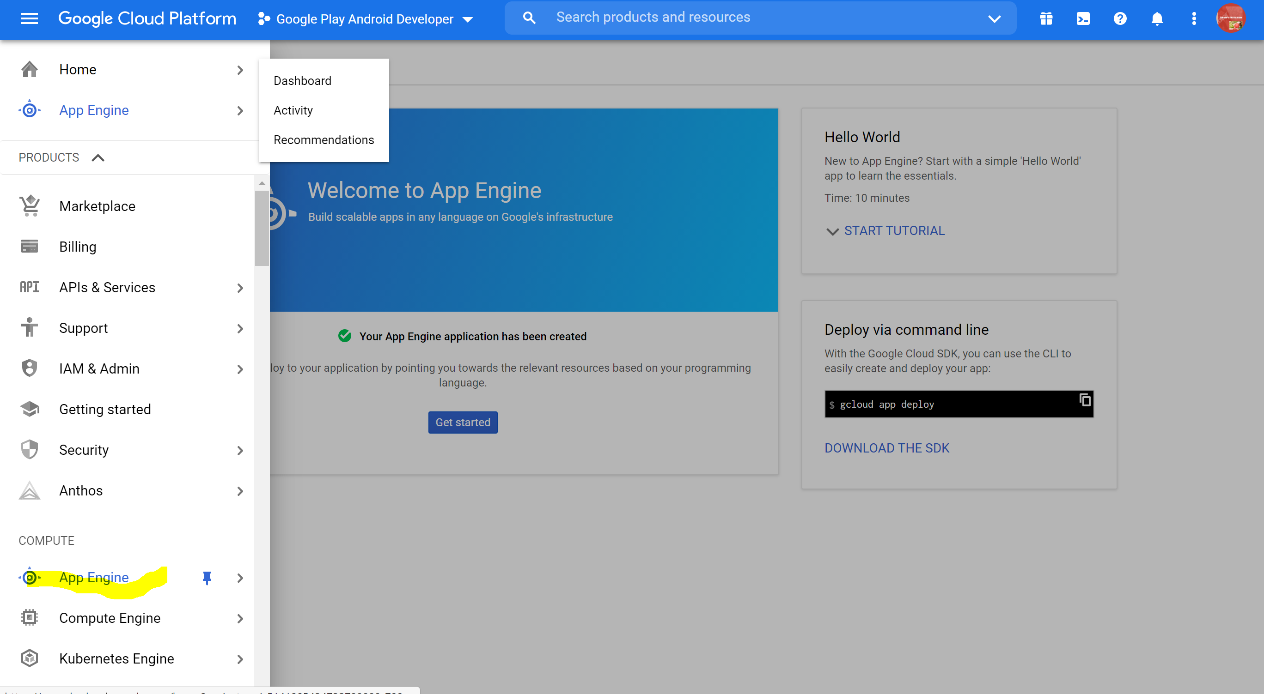
Set up a cloud instance (app engine)
App engine is a fully managed environment lets you focus on code while App Engine manages infrastructure concerns.
Login to cloud console (https://console.cloud.google.com/)
Search for app engine or click on the menu and go to compute section and select app engine from the list
For every project one app engine instance will be available
You can have single web application or micro service based applications under app engine

Slide 9
Create and deploy your first app
Let create a small hello world app based on react and nodejs
Lets deploy the app via gcloud sdk ( makes sure gcloud installed in your machine)
Login to gcloud using gcloud auth login command
Create app named helloworld which displays helloworld
Set up application deployment yaml ( app.yaml)
Push code to git
Deploy

Slide 10
Deploy frontend to appengine
Create app.yaml file,
runtime: nodejs12
instance_class: F4_1G
handlers:
- url: /
static_files: build/index.html
upload: build/index.html
- url: /(.*)
static_files: build/\1
upload: build/(.*)

Slide 11
Deploy backend to appengine
Create app.yaml file,
runtime: nodejs12
service: todo-api
instance_class: F4_1G
handlers:
- url: /.*
script: auto
secure: always
redirect_http_response_code: 301

Slide 12
Deployed instance
https://api-5141905434732799880-799674.uc.r.appspot.com/

Slide 13
Useful links
Google Cloud Platform Developers Portal: https://cloud.google.com/developers
Google Developers Global Portal: https://developers.google.com
Google Cloud Platform Products list: https://cloud.google.com/products/compute-engine/
Understanding Google APIs: https://fethidilmi.blogspot.com/2013/01/understandinggoogle-apis.html

